Slide 1
Network Models
Covers Chapter# 02 from Text Book
Computer Communication & Networks
(CEN-223)
Fall 2022 (BSE-5A)

Slide 2
Layered Architecture
Network layering: a modularity process that enables the breakup of complex communication tasks into smaller and simpler tasks by dividing them between different layers.
Layer N relies on services of layer N – 1 through interfaces.
A layer can be seen as a black box with inputs and outputs.
If any two protocols within the same layer can provide same type of output when given the same type of input, the protocols can replace each other.

Slide 3
Layered Architecture (Cont.)
Advantages of layered architecture:
Information/complexity hiding
Change in layer N doesn’t affect other layers
Some nodes require services of specific layers only and not all the layers. Hence, reducing nodes development effort and cost.

Slide 4
Network Models
Two models that have been devised to define computer network operations are:
TCP/IP protocol suite
The OSI model
Note: we will focus on the TCP/IP protocol suite (which is the most widely adopted). The OSI model is briefly discuss for comparison with the TCP/IP protocol suite.

Slide 5
TCP/IP Protocol Suite

Slide 6
TCP/IP Layers
TCP/IP (Transmission Control Protocol/ Internet Protocol).
TCP/IP protocol suite: a set of protocols organized in different layers used in the Internet nowadays.
Five ordered layers.
Layers in the TCP/IP protocol suite are almost implemented in software; while physical layer is mostly hardware.

Slide 7
Physical connection path between source and destination in TCP/IP protocol suite

Slide 8
Logical connections between layers of TCP/IP protocol suite

Slide 9
TCP/IP Layers (Cont.)
There exists logical connections between each layer in the network models, hence we have layer-to-layer communication.
Generally speaking:
The duty of the application, transport, and network layers is end-to-end.
The duty of the data-link and physical layers is hop-to-hop.

Slide 10
Physical Layer
In general, it manages all those functions that are required to carry bits over a physical medium.
It also deals with mechanical and electrical/optical specifications of the interface and transmission medium.
The logical unit between two physical layers is a bit.

Slide 11
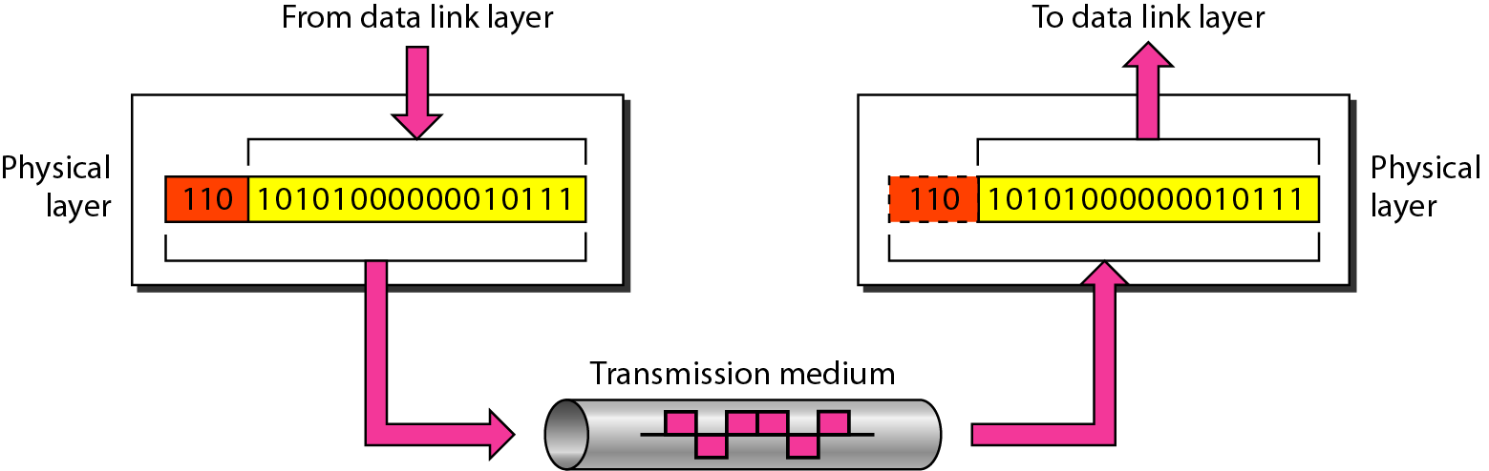
Physical Layer (Cont.)

Slide 12
Physical Layer (Cont.)
Services of Physical Layer:
Representation of bits: bits must be encoded into signals (electrical/optical). Physical layer defines the type of encoding, hence how 0s and 1s are changed into signals.
Data rate: the number of bits sent each second.
Synchronization: sender and receiver clock must be synchronized.
Line configuration: point-to-point or multipoint.
Topology: how devices are physically connected to each other.
Data Flow mode: simplex, half-duplex, full-duplex.

Slide 13
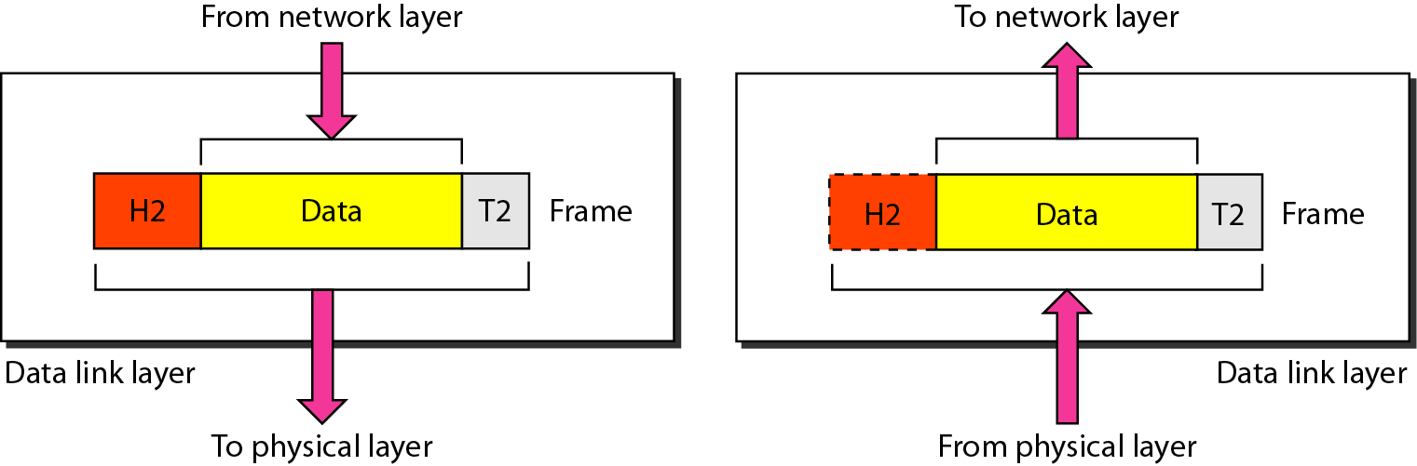
Data Link Layer
Mainly, adds reliability to data transmission.
The data-link layer takes the data from the network layer and encapsulates it into a packet called a frame.

Slide 14
Data Link Layer (Cont.)
Services of Data-Link Layer:
Framing: construction of a frame.
Flow control: controlling the transmission rate at the sender to avoid data overwhelming at the receiver.
Error control: adds reliability to the physical layer by using mechanisms to detect and correct damaged frames.
Access control: controls which device has access to the shared link at any given time, e.g. in WLANs.
Physical address: adds a header to define the physical address of sender/receiver of a frame within the same network.

Slide 15
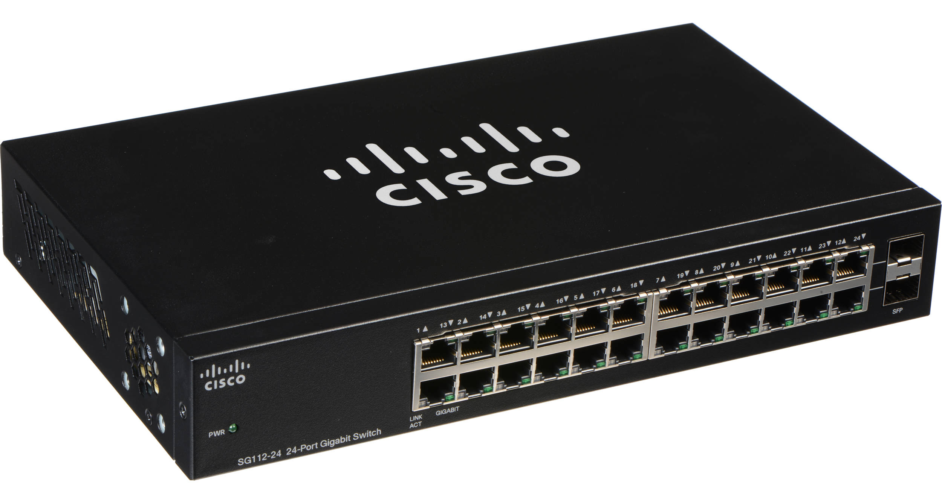
Data Link Layer (Cont.)
Switch is a Data Link Layer (i.e. layer 2) connecting device.

Slide 16
Network Layer
The network layer is mainly responsible for routing the packet through possible routes.
There can be several routers from source to destination.
Routers are responsible for choosing the best route for each packet.
The main protocol in network layer is Internet Protocol (IP), that defines format of packet.
The Internet Protocol also defines format and structure of addresses used in this layer.

Slide 17
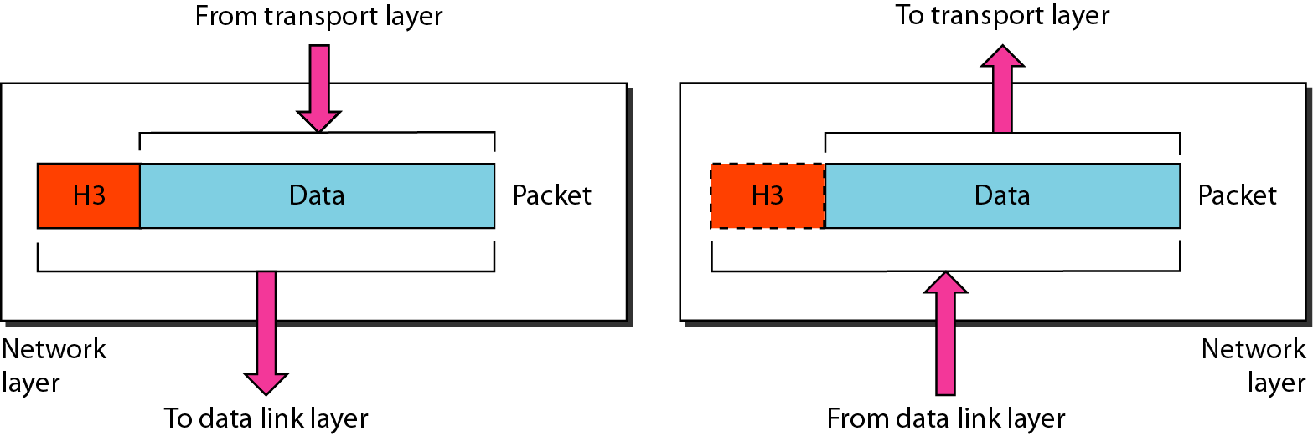
Network Layer (Cont.)
A packet in the network layer is called a datagram.

Slide 18
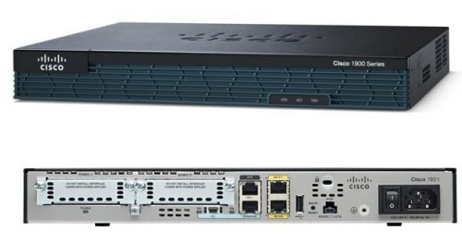
Network Layer (Cont.)
Router is a Network Layer (i.e. layer 3) connecting device.

Slide 19
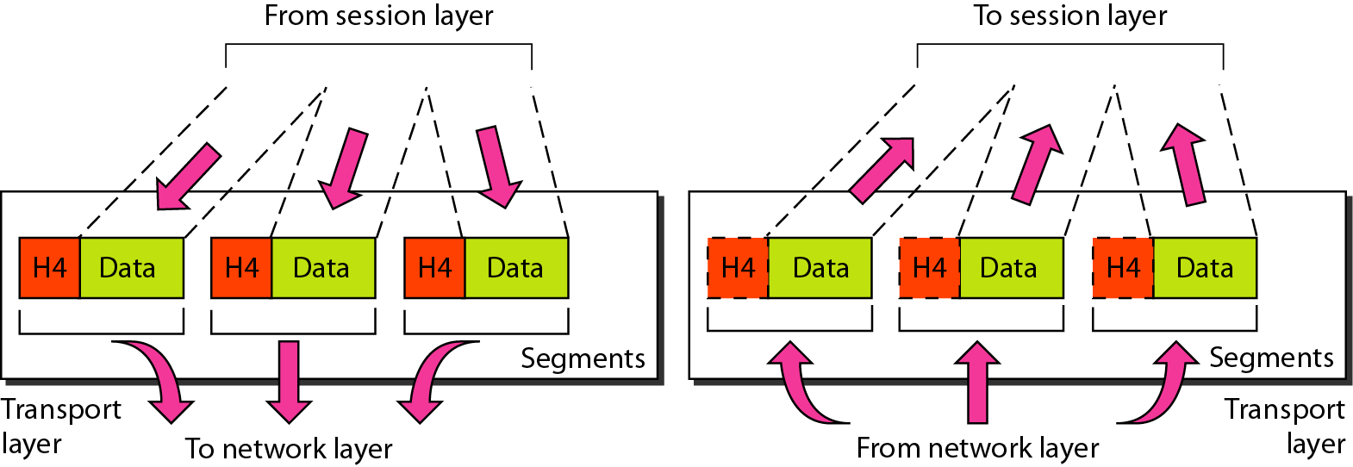
Transport Layer
Its main task is to provide an end-to-end flow control, error control and congestion control.
Transport layer gets a message from the application layer and encapsulates it in a transport layer packet called a segment.
From Application Layer To Application Layer

Slide 20
Transport Layer (Cont.)
Services of Transport Layer:
Segmentation and reassembly: message is divided into segments with each segment containing a sequence number. These numbers are used in message reassembly and identify and replace lost packets.
Connection control: either connection-oriented or connectionless.
Error control: process-to-process error control, which is usually achieved through retransmission.
Port address: to identify the delivery to specific process to its concerned application.

Slide 21
Transport Layer (Cont.)
Popular Transport layer protocols:
Transmission Control Protocol (TCP) is a connection-oriented protocol (i.e. first establishes a logical connection between transport layers at two hosts before transferring data).
User Datagram Protocol (UDP) is a connectionless protocol (i.e. transmits user datagrams without first creating a logical connection).
Stream Control Transmission Protocol (SCTP) is designed to respond to new applications that are emerging in multimedia.

Slide 22
Application Layer
Its main task is process to process communication of the message, where a process is a running application program.
Any two application layers exchange messages between each other.
It enables the user to access the network using an application.
Note: a message is a packet at the application layer.

Slide 23
Application Layer (Cont.)
Popular Application layer protocols:
The Hypertext Transfer Protocol (HTTP) is a vehicle for accessing the World Wide Web (WWW).
The Simple Mail Transfer Protocol (SMTP) is the main protocol used in electronic mail (e-mail) service.
The File Transfer Protocol (FTP) is used for transferring files from one host to another.
The Terminal Network (TELNET) and Secure Shell (SSH) are used for accessing a site remotely.
The Domain Name System (DNS) is used by other protocols to find the network-layer address of a computer.

Slide 24
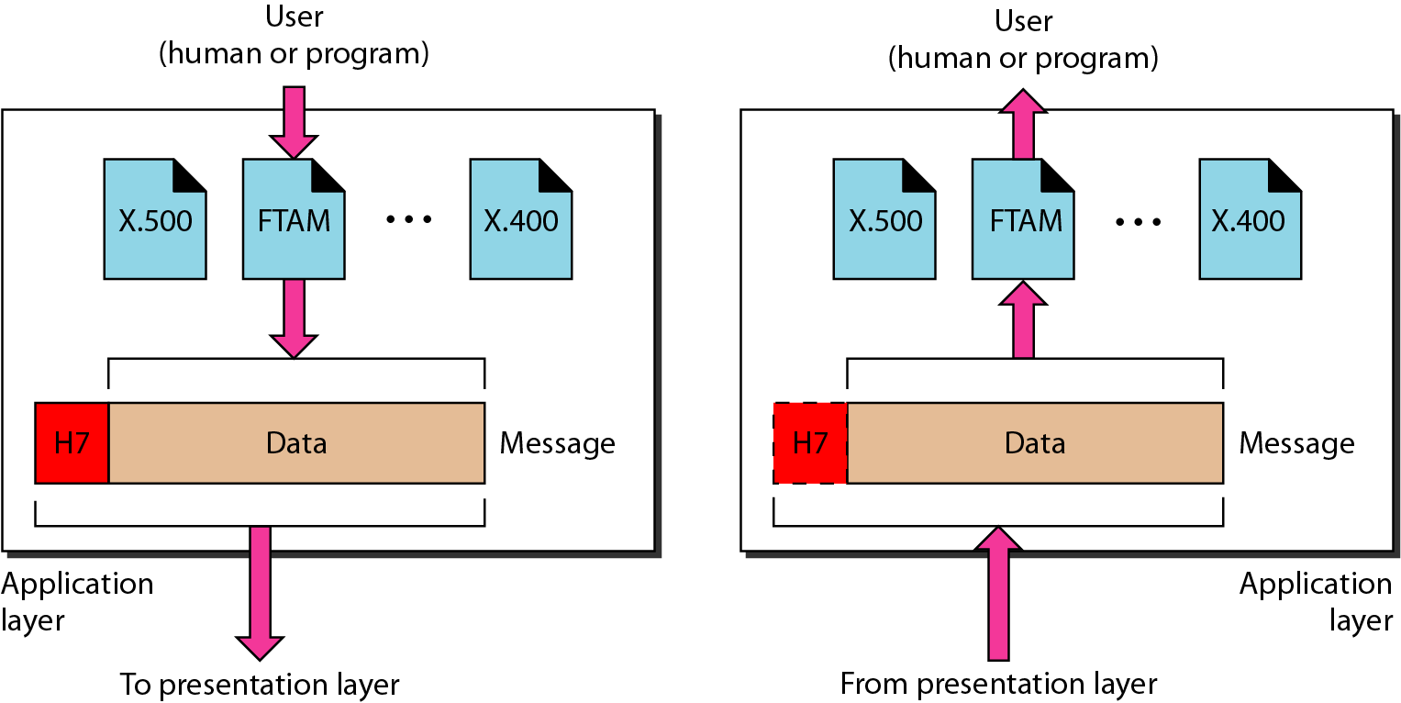
Application Layer (Cont.)
To Transport Layer From Transport Layer

Slide 25
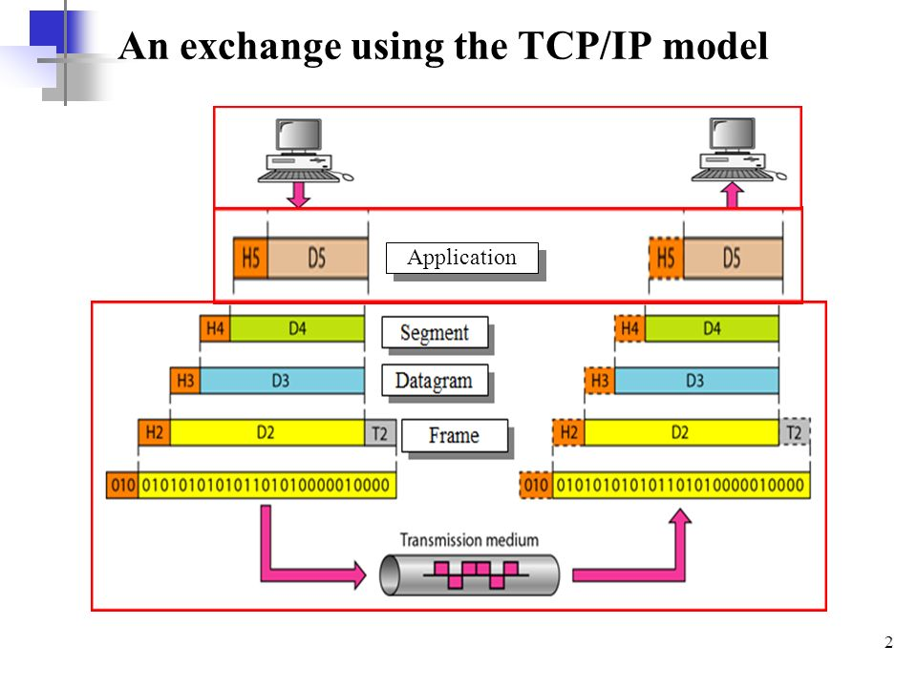
Encapsulation and Decapsulation
Encapsulation
Decapsulation

Slide 26
Addressing
Four levels of addresses are used in an internet employing the TCP/IP protocol suite, which are the physical, logical, port, and specific addresses.
In the TCP/IP protocol suite, there is a relation between the layer and the address used in that layer, except for the physical layer.

Slide 27
Addressing (Cont.)
Application layer → Specific address, e.g. website name, email address.
Transport layer → Port address, these are local address.
Network layer → Logical address, these are global address, such as IP addresses.
Data link layer → Physical address, usually referred to as MAC address.

Slide 28
Addressing (Cont.)
Specific addresses
Port addresses
Logical addresses
Physical addresses

Slide 29
Multiplexing and Demultiplexing
The TCP/IP protocol suite uses several protocols at different layers, hence we have multiplexing at the source and demultiplexing at the destination.
Multiplexing in TCP/IP model means that a protocol at a layer can encapsulate a packet from several next-higher layer protocols (one at a time).
Demultiplexing in TCP/IP model means that a protocol can decapsulate and deliver a packet to several next-higher layer protocols (one at a time).

Slide 30
Multiplexing and Demultiplexing (Cont.)
Example of MUX/DEMUX over TCP/IP protocol suite.

Slide 31
OSI versus TCP/IP
The TCP/IP Protocol suite consists of five ordered layers.
The OSI model consists of seven ordered layers.

Slide 32
Thank You!

